Slide 1
Sea level rise
Silvia Caldararu
Email: caldaras@tcd.ie

Slide 2

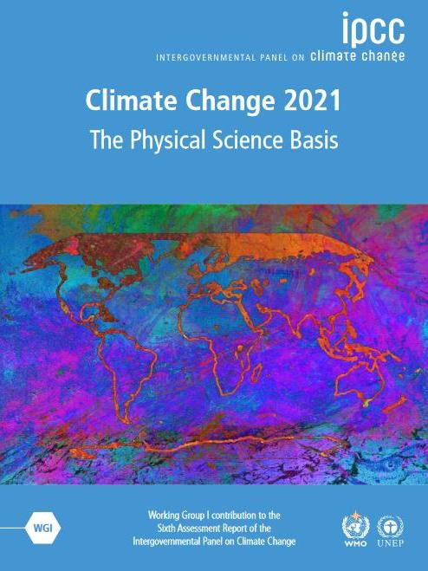
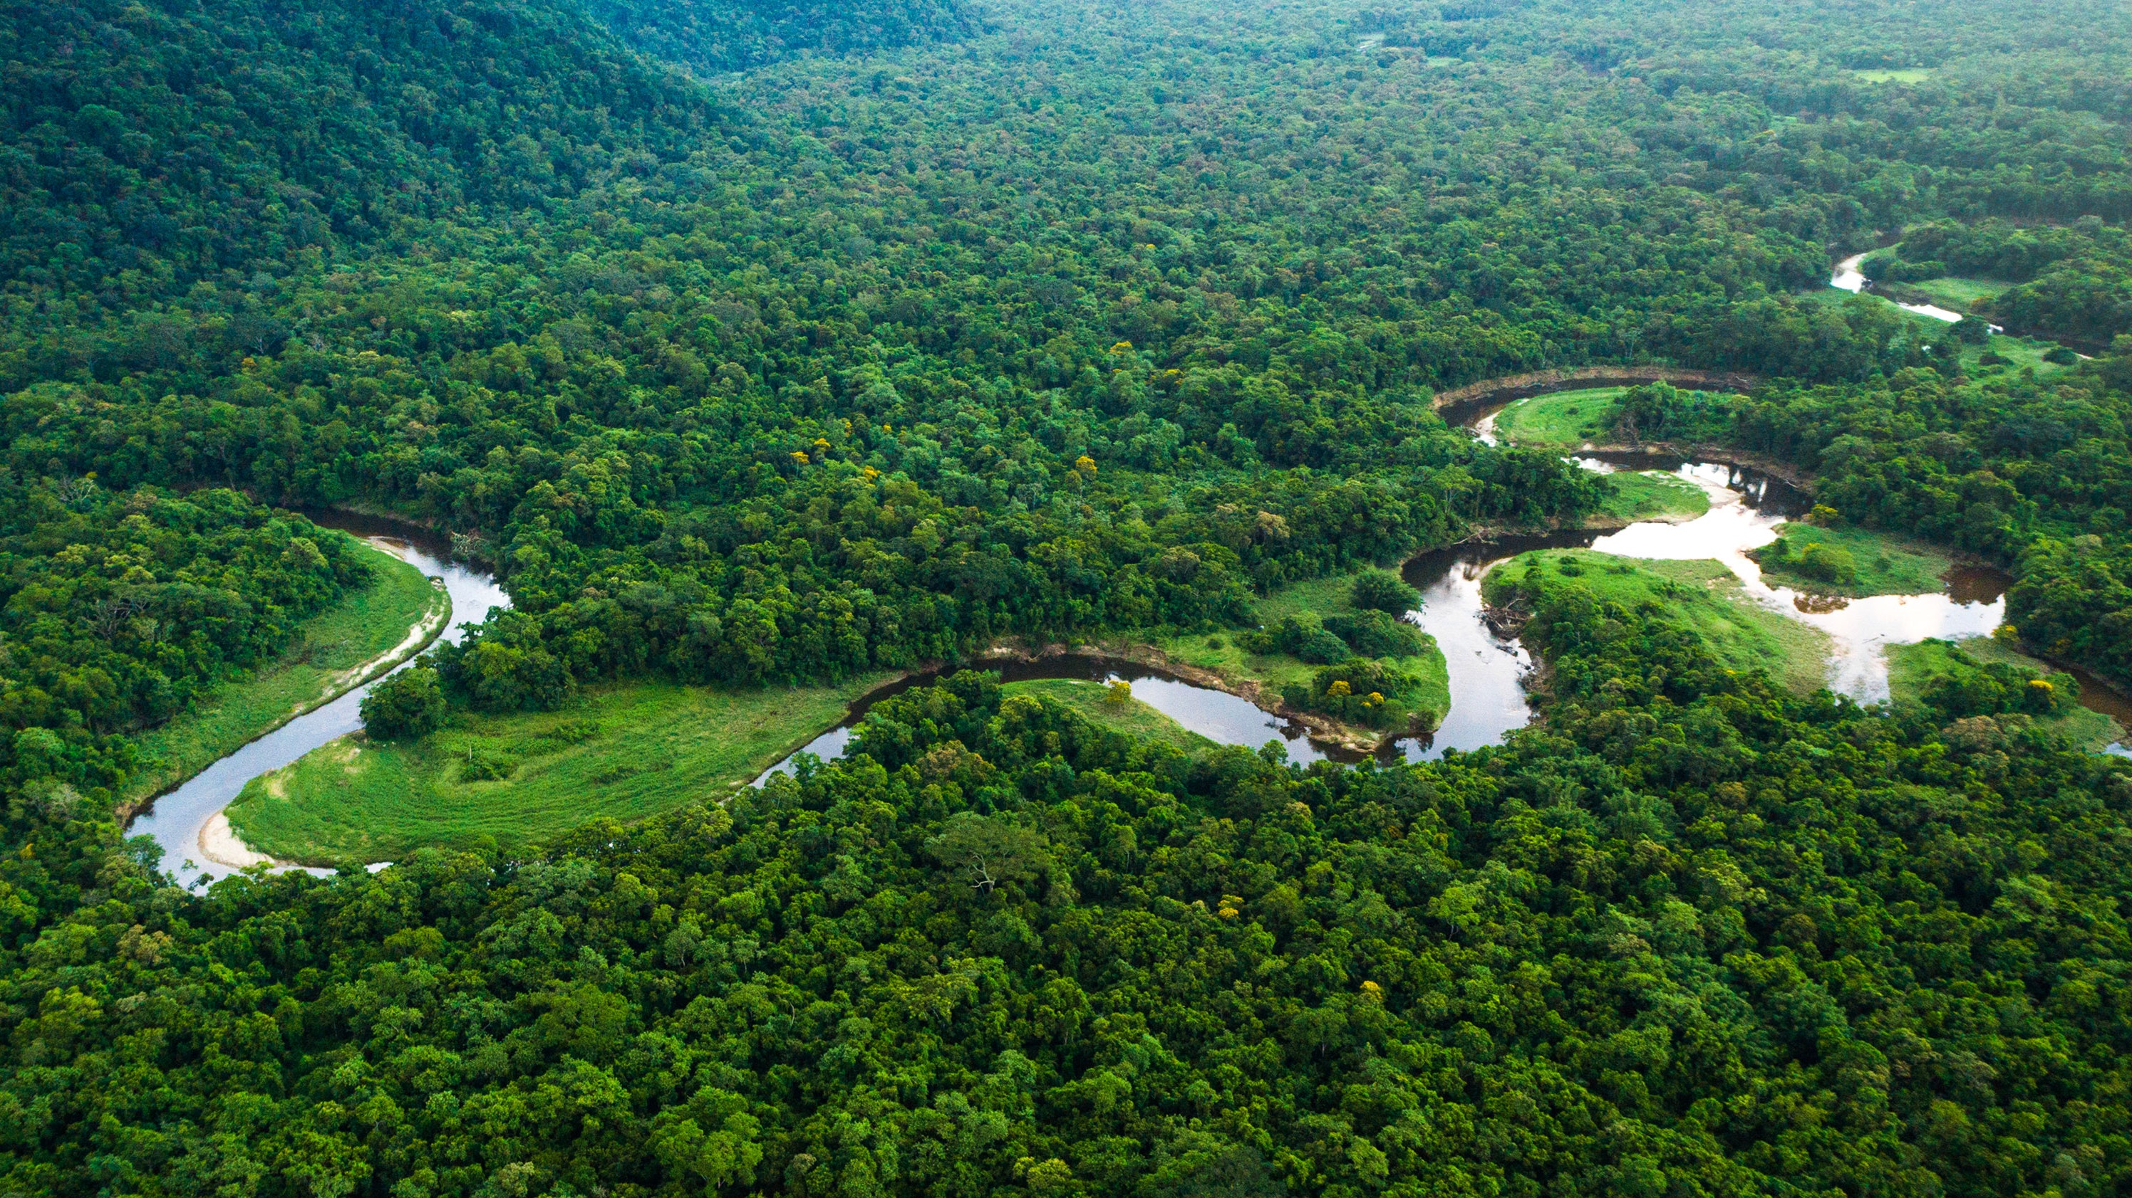
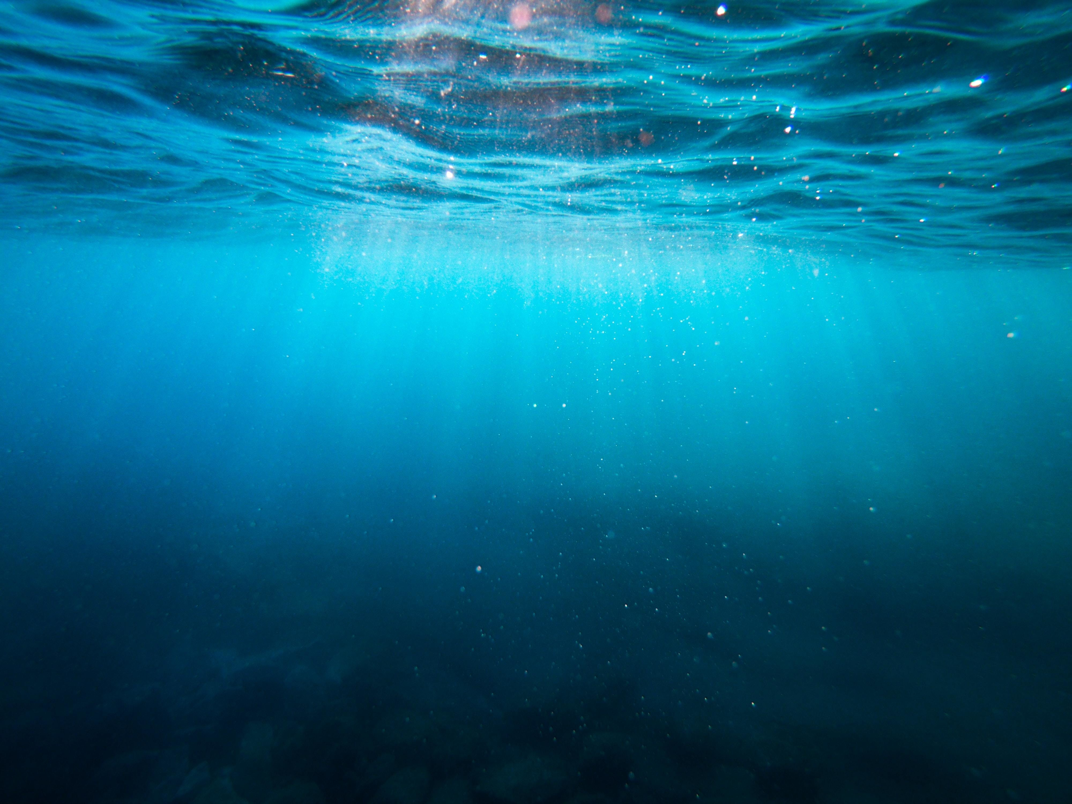
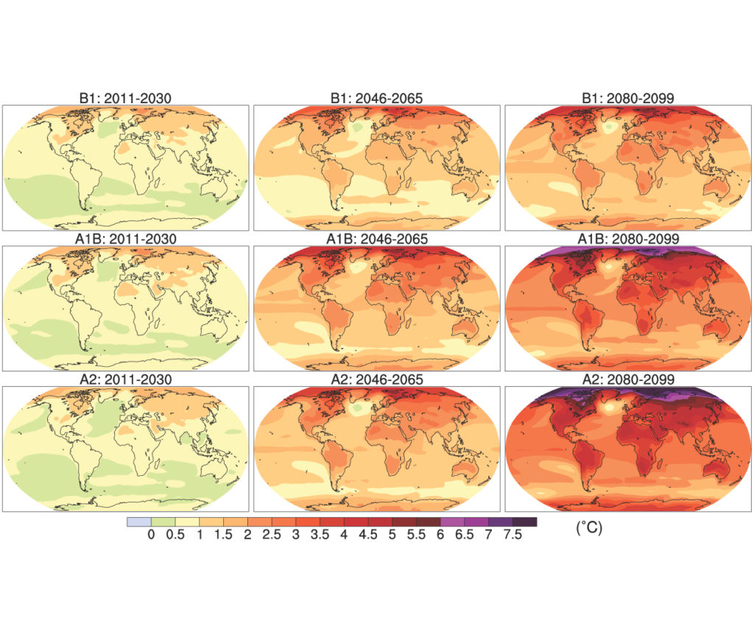
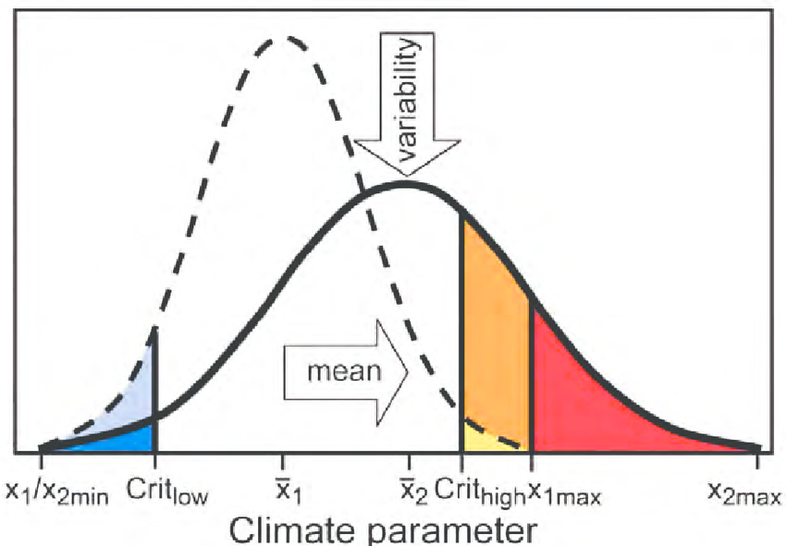
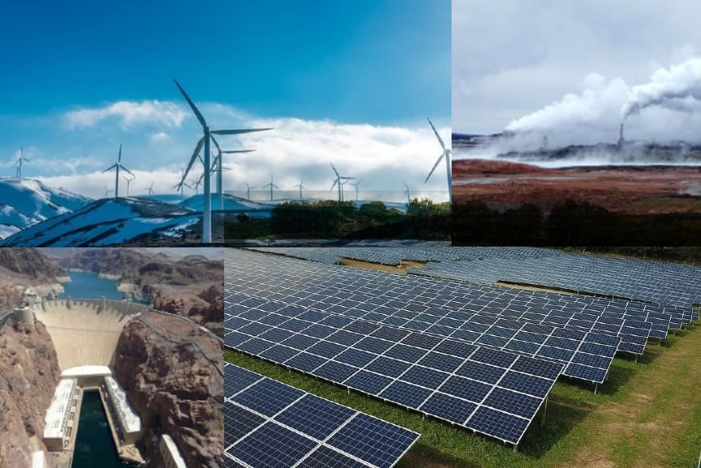
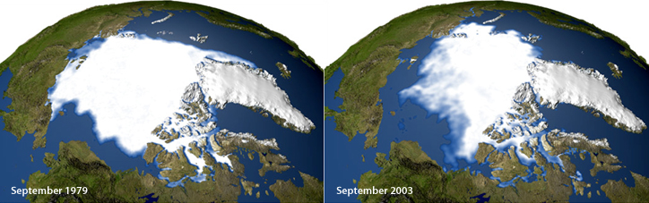
Atmosphere
Climate fundamentals
Predicting climate
Atmosphere
Global C cycle
IPCC report
Earth system models
Climate impacts
Climate solutions
Extreme events
Tipping points
Sea ice, ice caps
Energy
Mitigation
Nature-based solutions

Slide 3
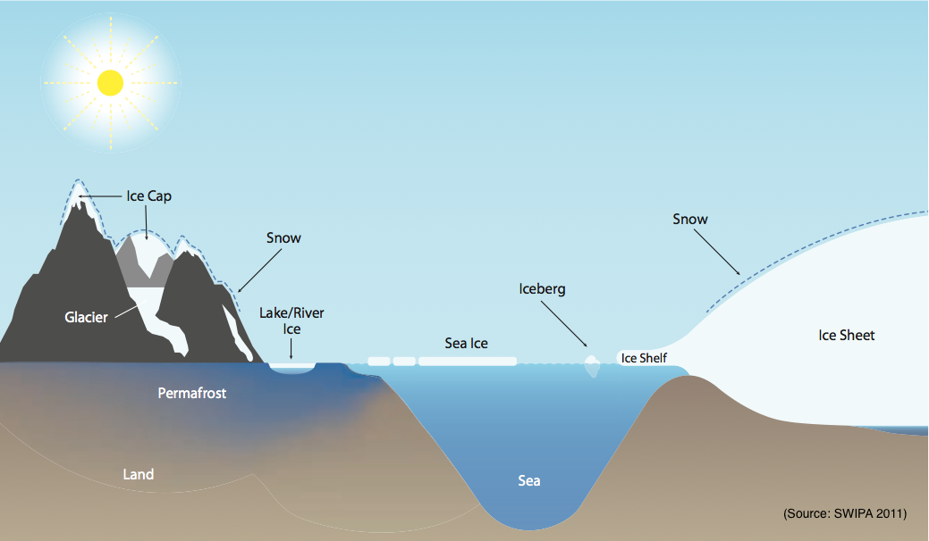
The cryosphere

Slide 4
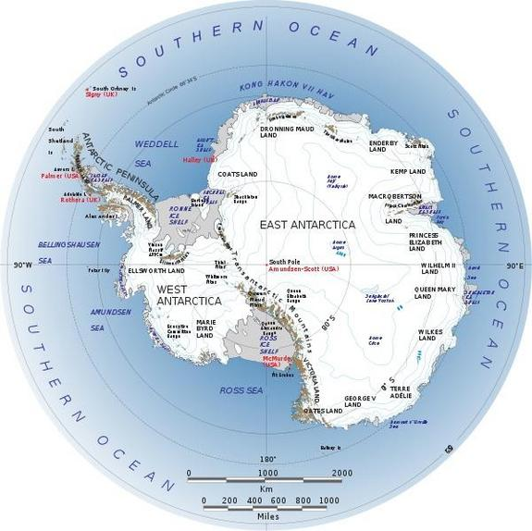
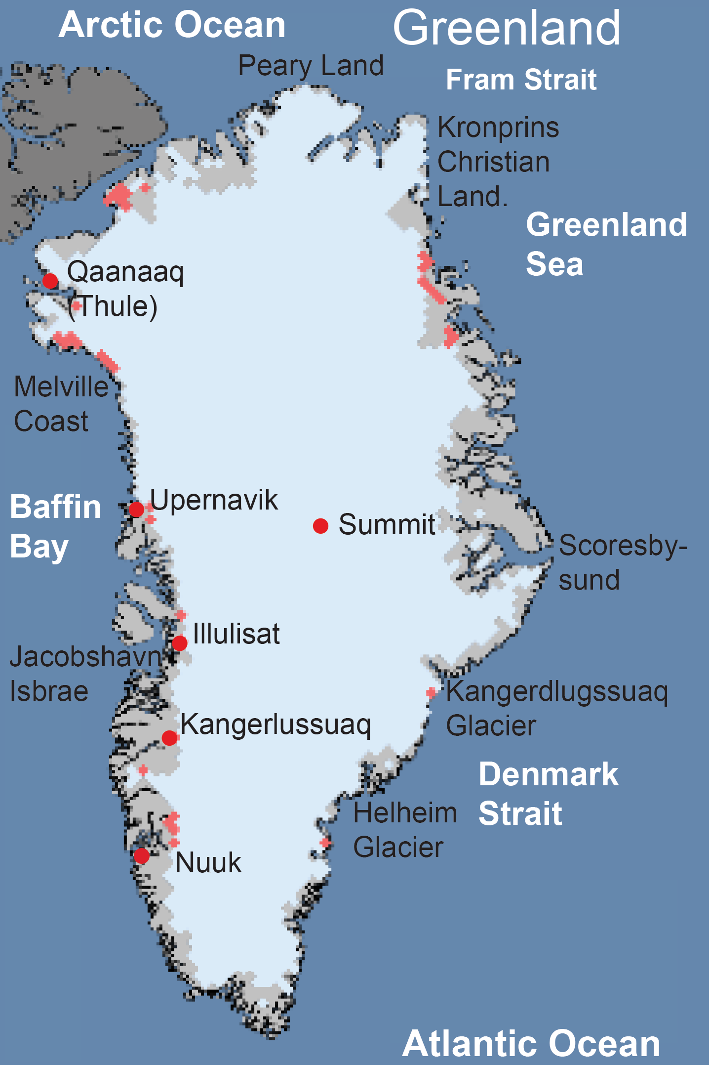
Ice sheets
Continental-scale masses of ice
Formed over hundreds – millions of years
68% of all freshwater on Earth and over 99% of freshwater ice.
Ice shelves – permanent ice attached to a continental mass

Slide 5
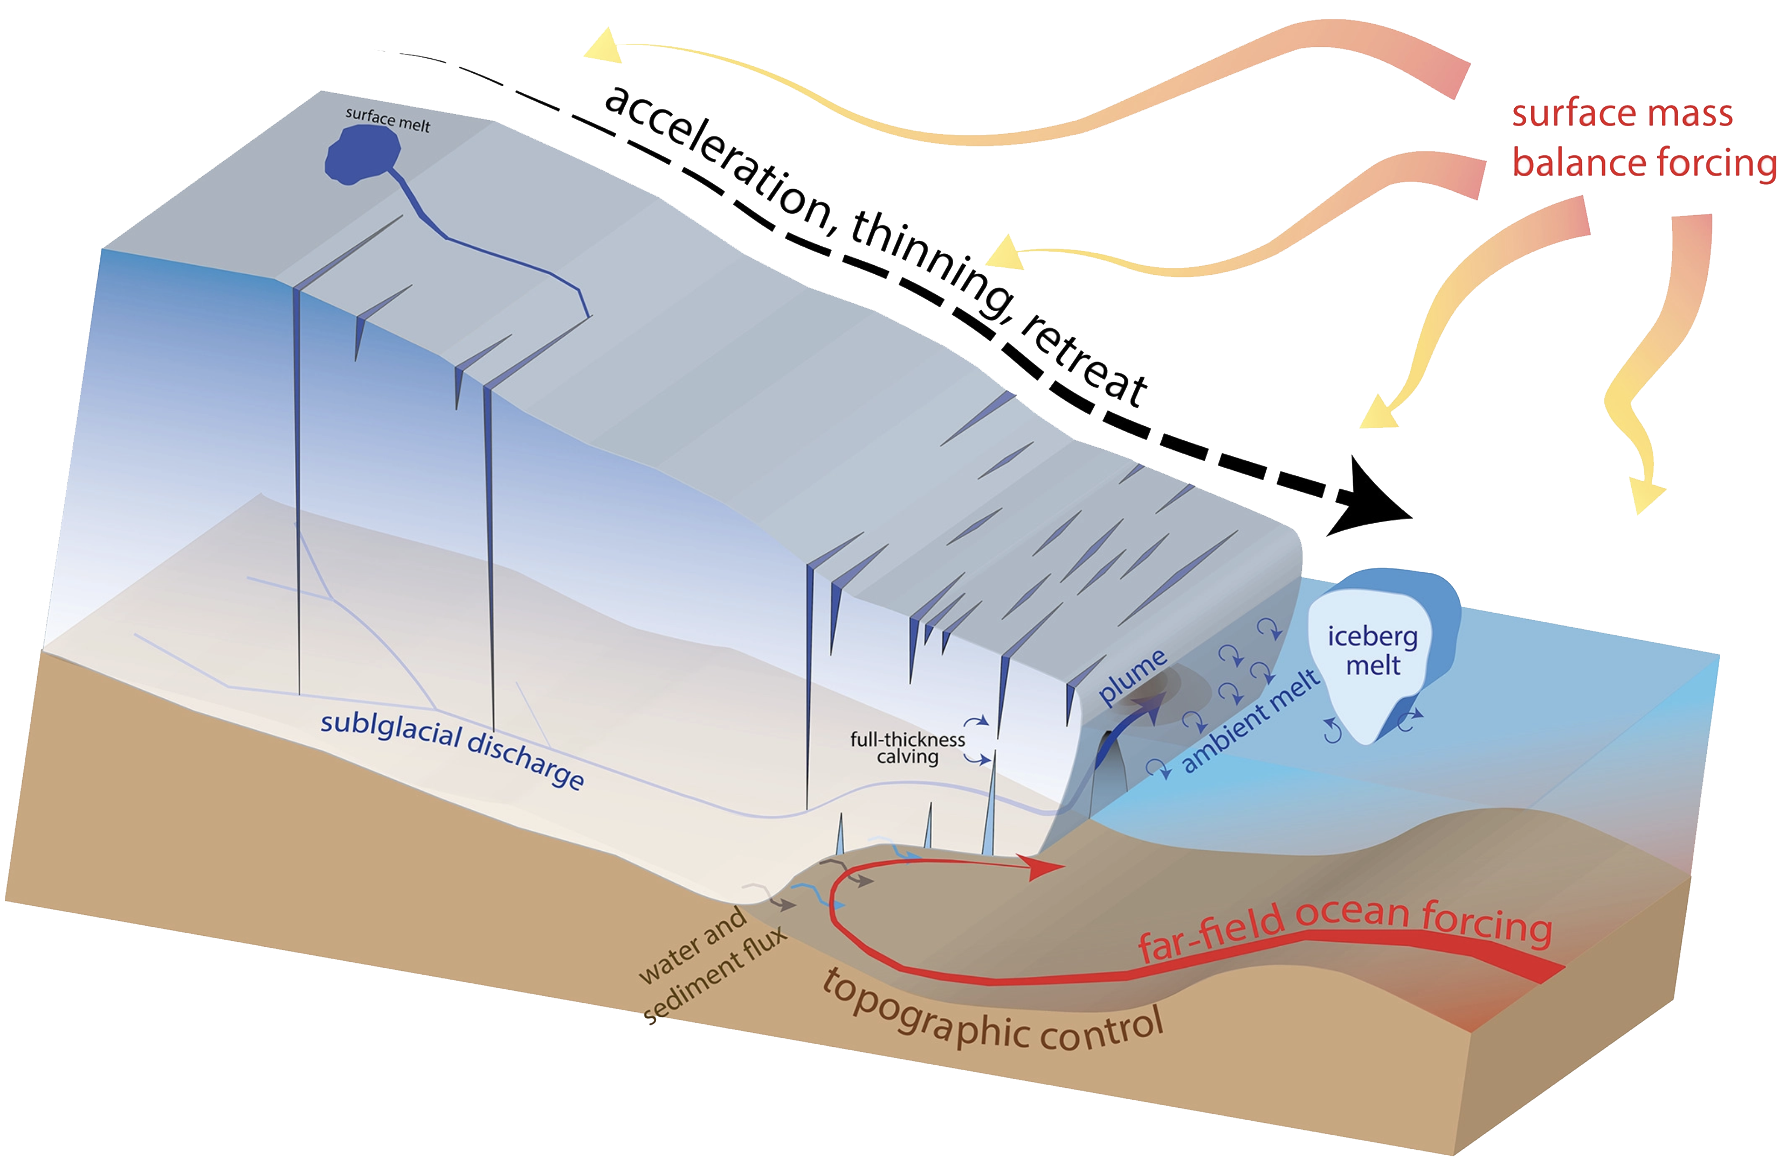
Ice sheets are not static
Ice accumulates from snowfall
Ice flows into the sea in the form of ice shelves
Ice thinning can lead to calving and breaking off of icebergs

Slide 6
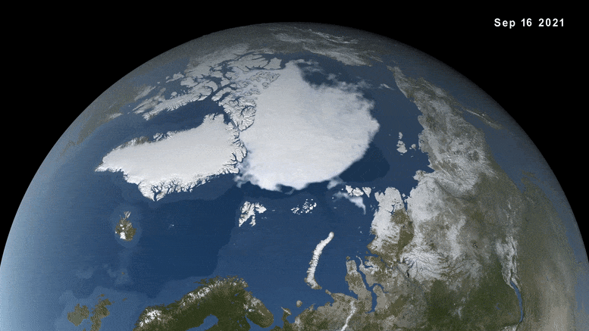
Sea ice
Frozen sea water
Mostly in the Arctic Ocean but also in the ocean around Antarctica
Seasonal extent
Ice shelf – fresh water, sea ice – sea water

Slide 7
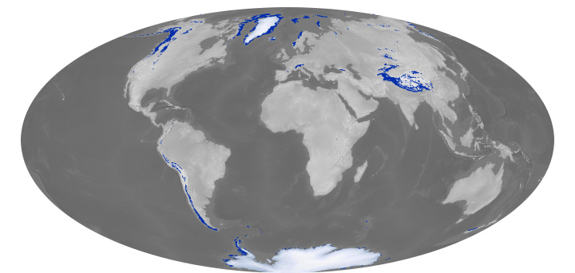
Glaciers
Permanent bodies of ice
At high altitudes where temperatures are below freezing the whole year

Slide 8
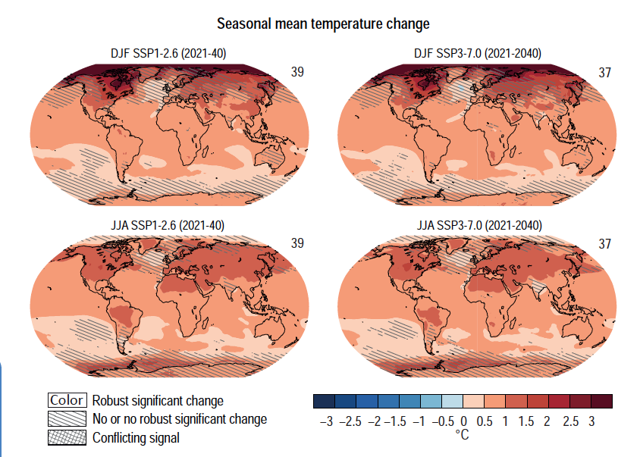
Near-term global surface temperature increase
Larger increase over land
Larger increase in the Northern hemisphere
Largest increase in the high Northern latitudes during boreal winter
Increase over Amazon basin during dry season
Notes:
IPCC WGI, chapter 4, figure 4.12

Slide 9
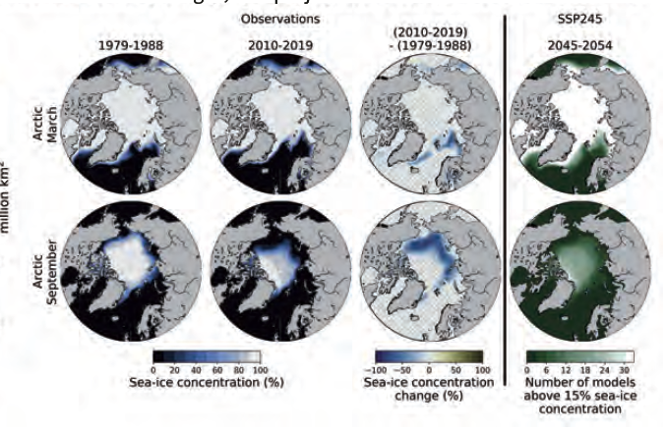
Changes in sea ice: Arctic
Severe reduction in sea ice cover
Differs by season
Notes:
IPCC WG I, chapter 9, figure 9.13

Slide 10
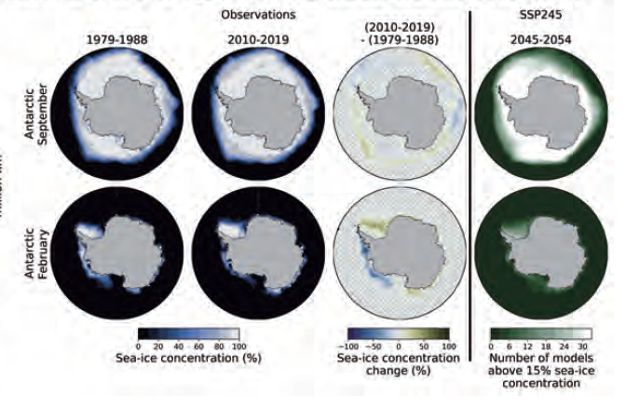
Changes in sea ice: Antarctic
Less severe than in the Arctic
Remember the albedo-temperature feedback
Notes:
IPCC WG I, chapter 9, figure 9.15

Slide 11
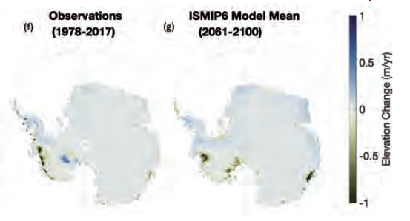
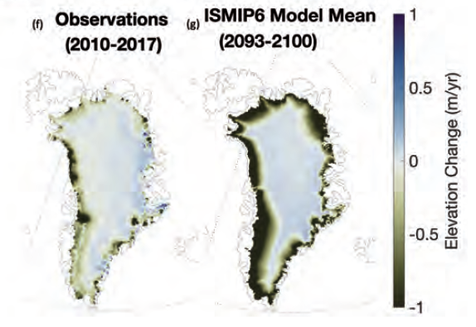
Changes in ice sheets
Similar patterns to sea ice melt
Notes:
IPCC WG I, chapter 9, figure 9.17

Slide 12
If it gets warmer, ice will melt. D’oh.
Sea level rise
Water supply loss
Habitat loss

Slide 13
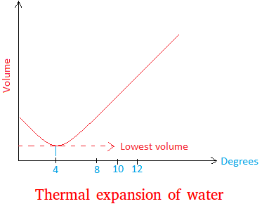
Sea level rise: thermal expansion
Water volume increases as temperature increases

Slide 14
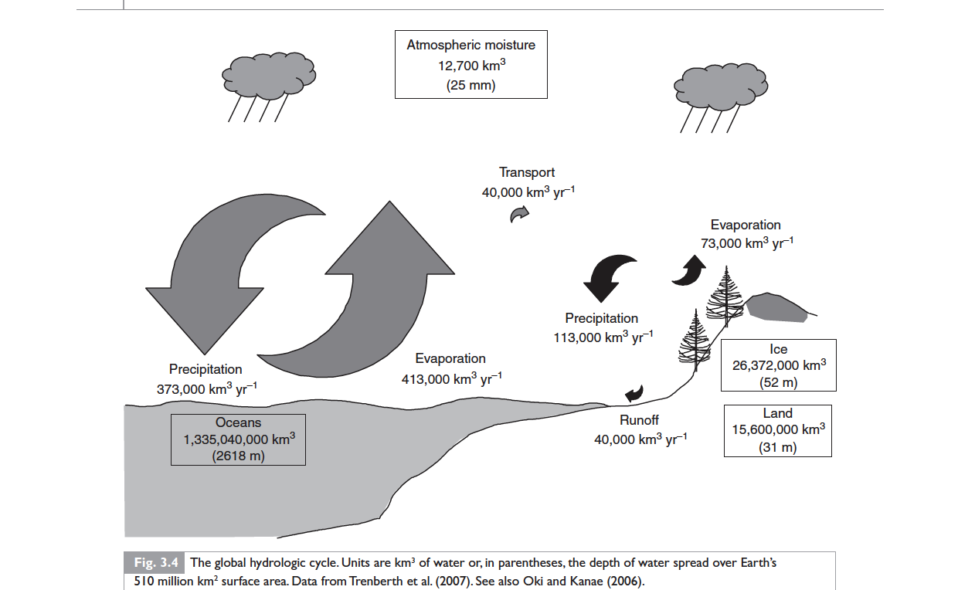
Sea level rise: land water storage
The amount of water in the Earth system is constant
If there are changes in precipitation or river discharge, the amount of water in the oceans will change too
This is important because precipitation patterns are projected to change with global warming

Slide 15
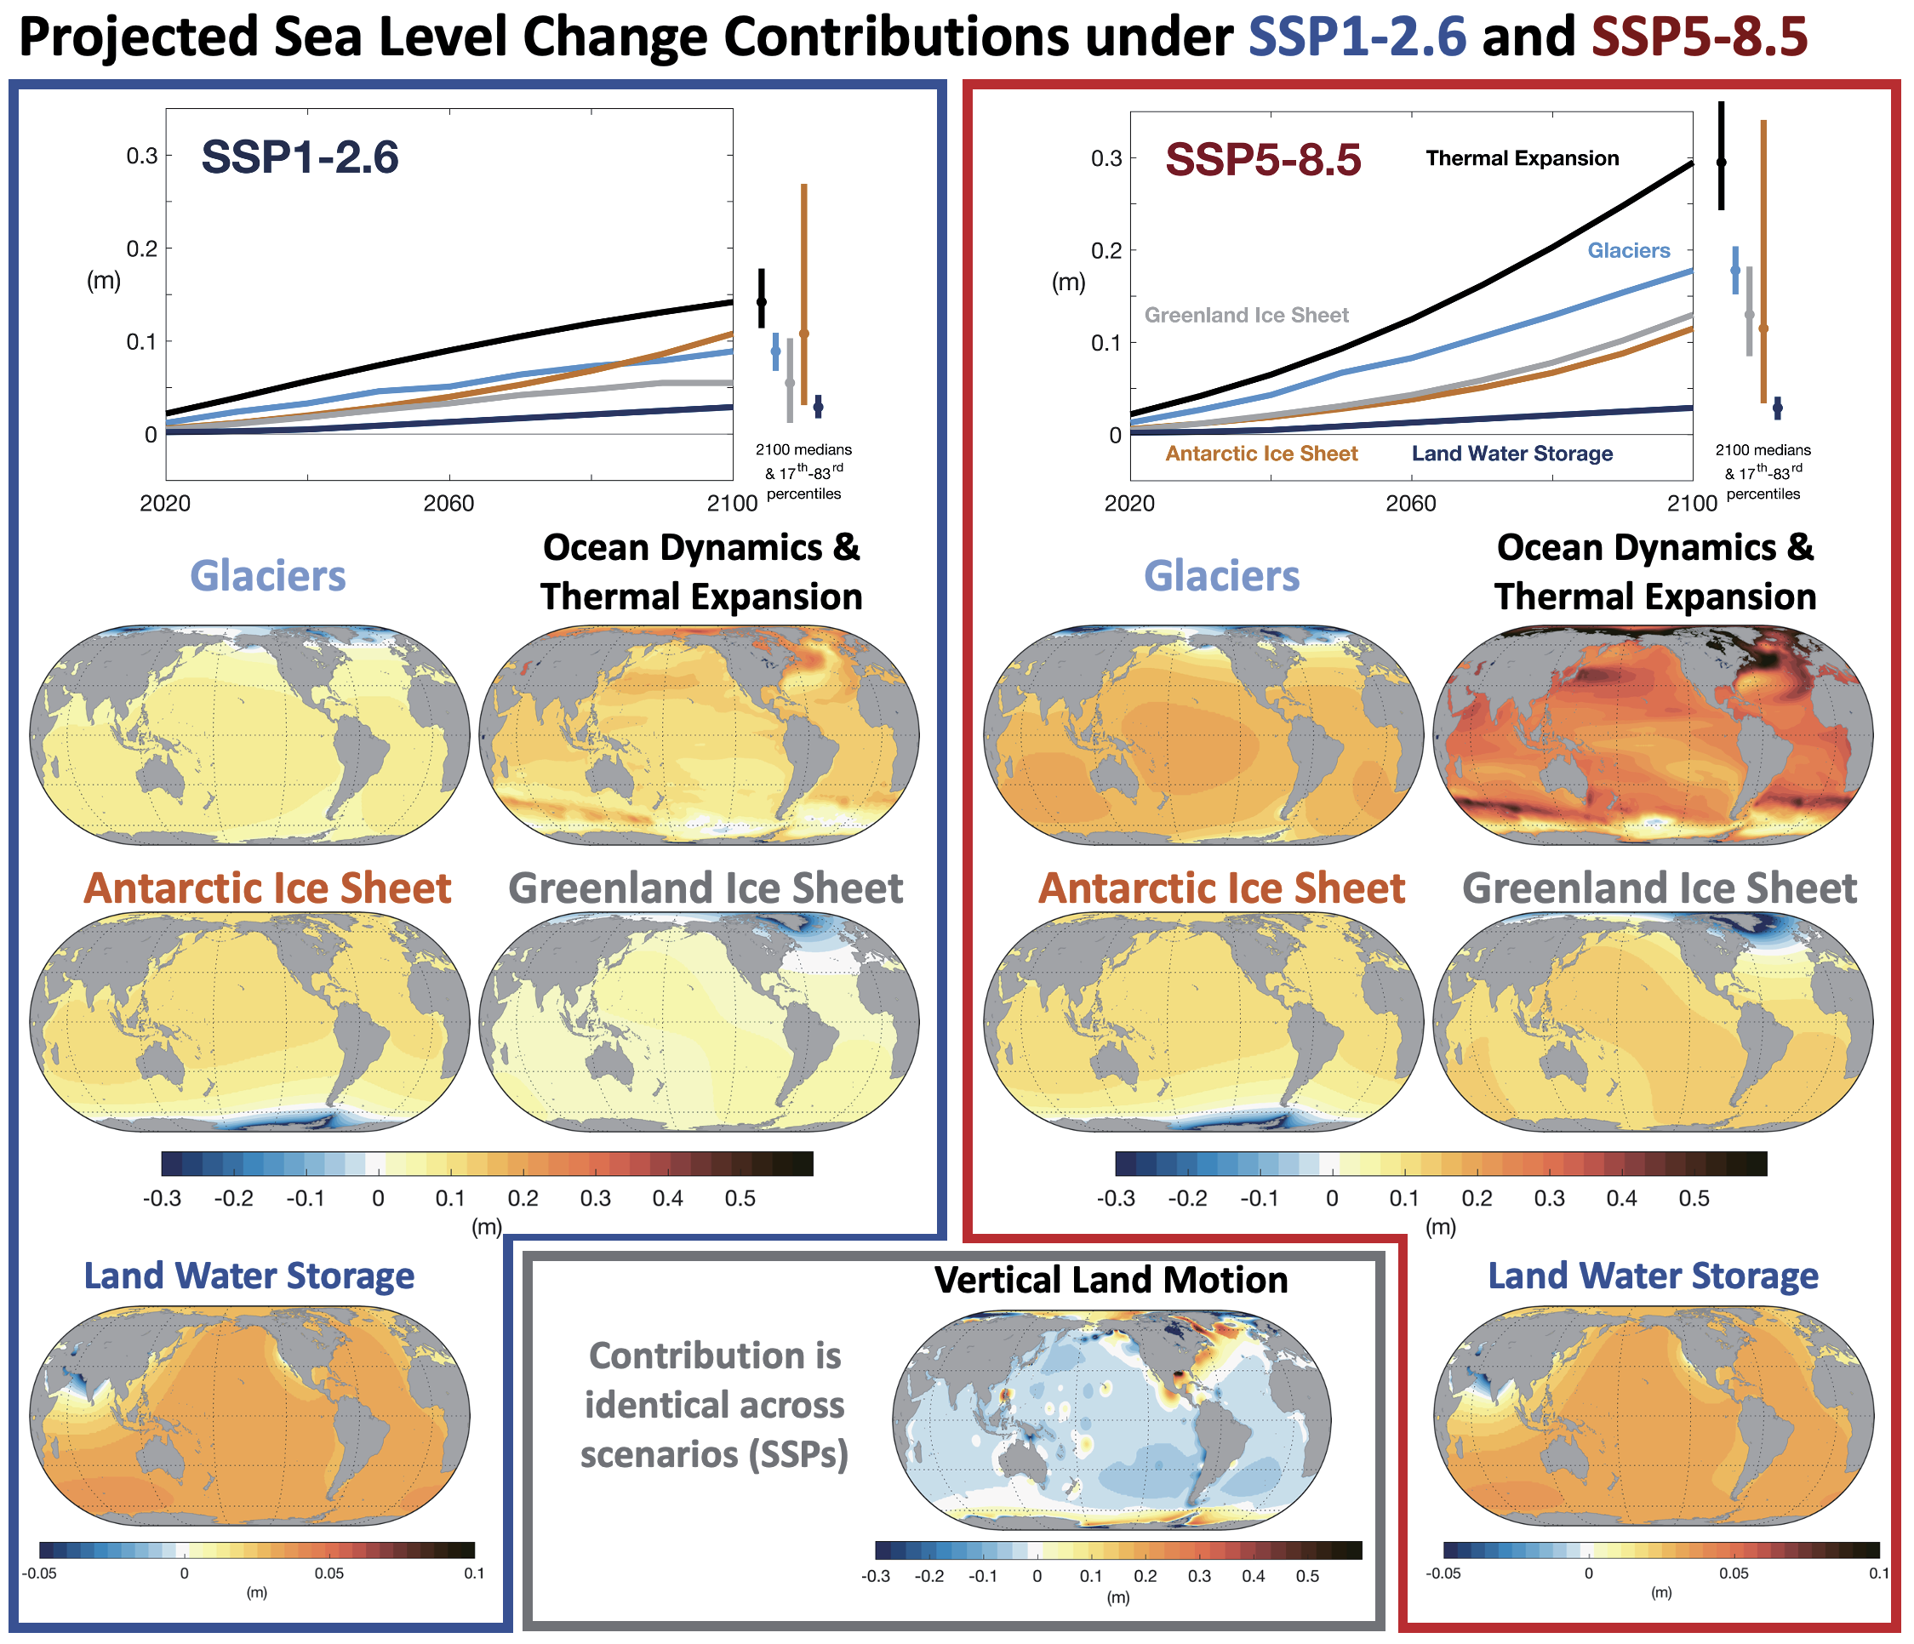
Notes:
IPCC WGI, chapter 9, figure 9.26

Slide 16
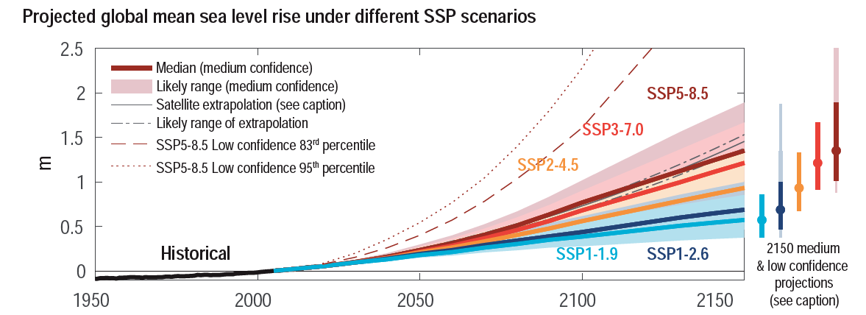
Sea level rise through the 21st century
Notes:
IPCC WGI, chapter 9, figure 9.27

Slide 17
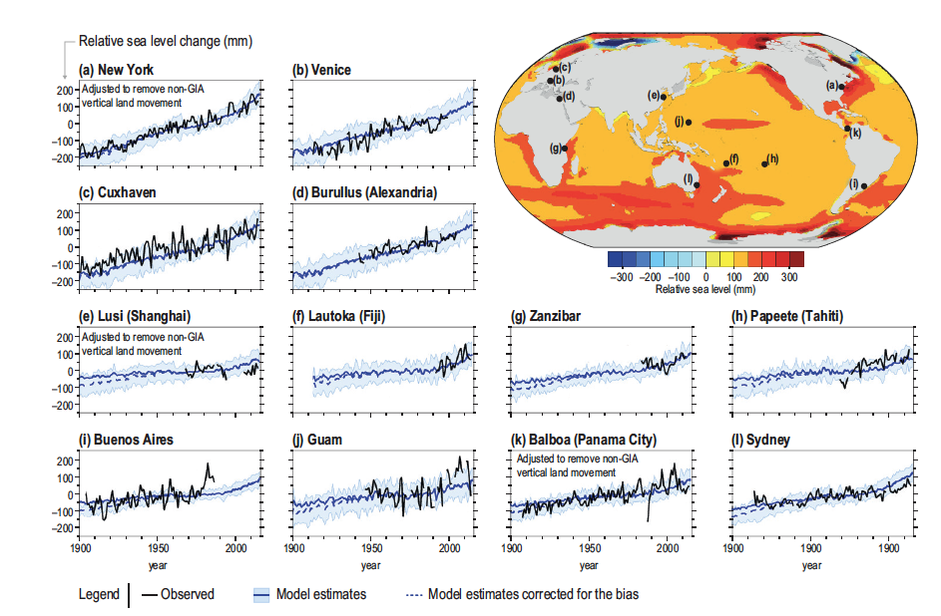
Sea level rise unevenly distributed
Patterns driven by ocean circulation and Earth’s uneven gravity field
Notes:
IPCC WGI, chapter 9, figure 9.28

Slide 18
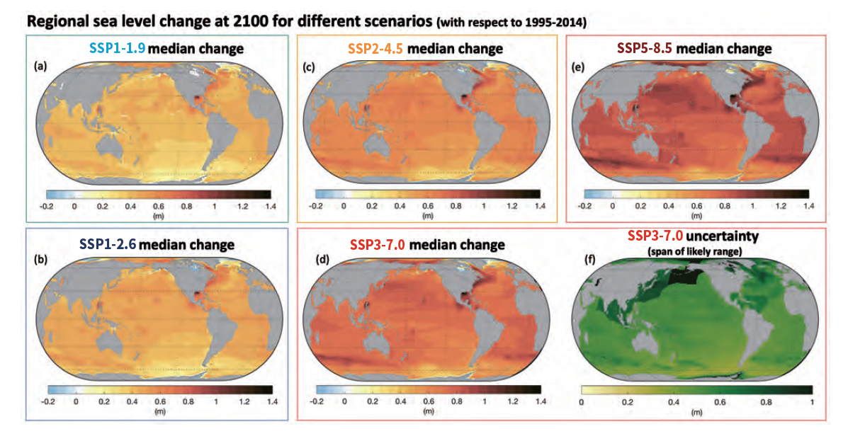
Sea level rise unevenly distributed
Patterns driven by ocean circulation and Earth’s uneven gravity field

Slide 19
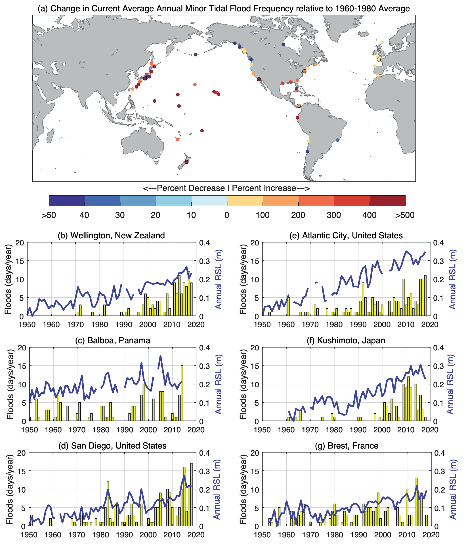
Beyond average sea levels: Tidal floods
Notes:
IPCC WGI, chapter 9, figure 9.31

Slide 20
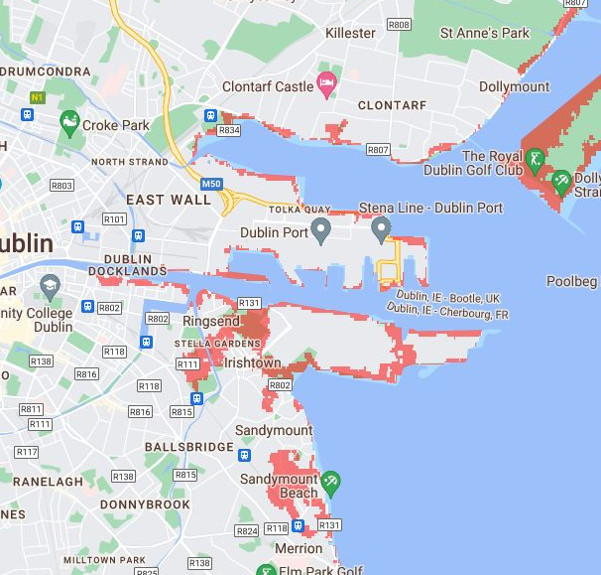
Sea level rise in Dublin at 1.5 m
https://coastal.climatecentral.org/

Slide 21
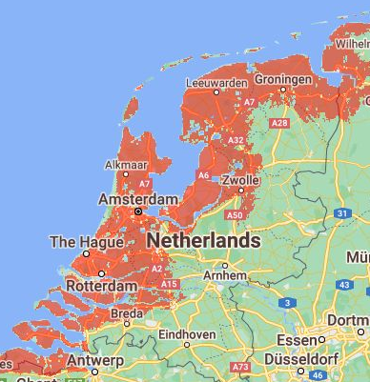
Sea level rise in the Netherlands at 1.5 m
https://coastal.climatecentral.org/

Slide 22
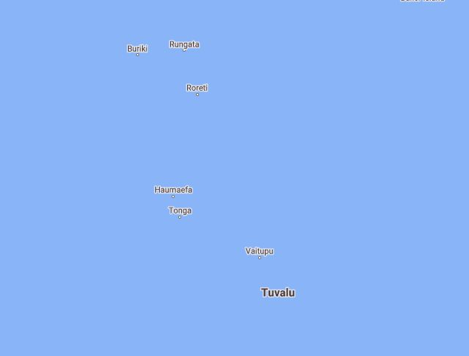
Sea level rise small island states at 1.5 m No data FFS
https://coastal.climatecentral.org/

Slide 23

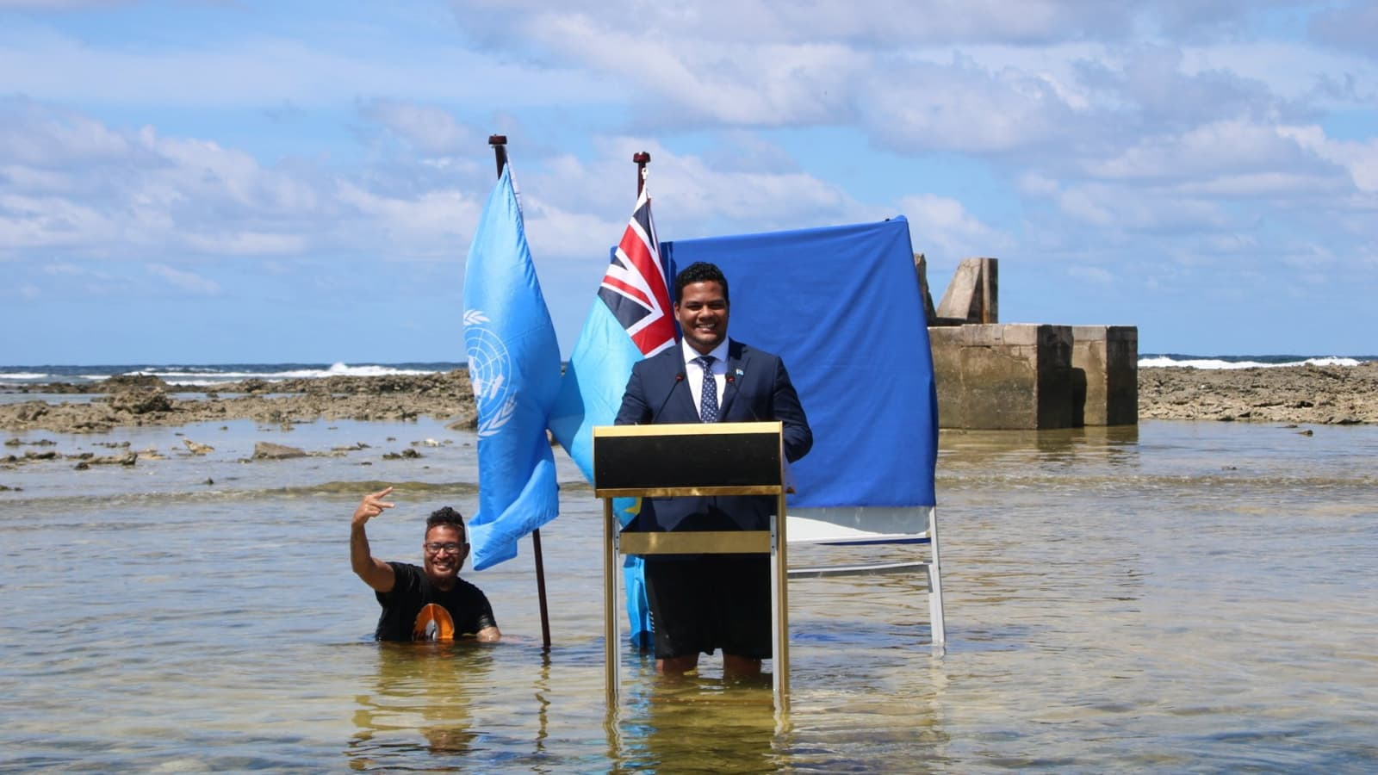
Alliance of small island states
Unofficial alliance of small islands
Very high impact os sea level rise because of high ratio of coast to total land
Low GHG emissions
Little political power

Slide 24
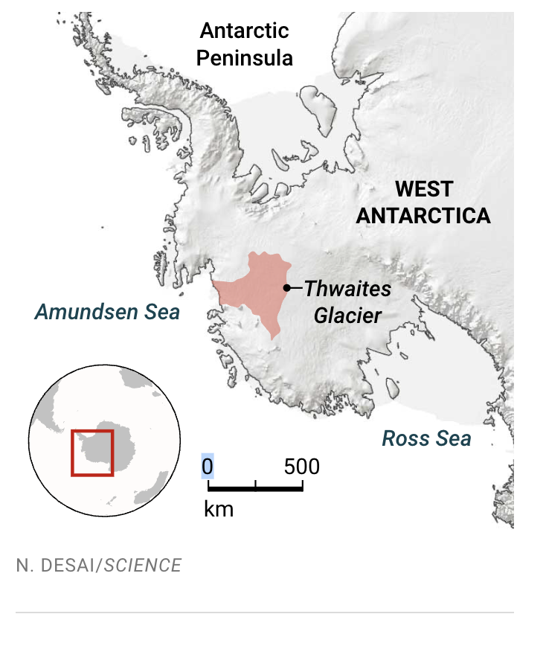
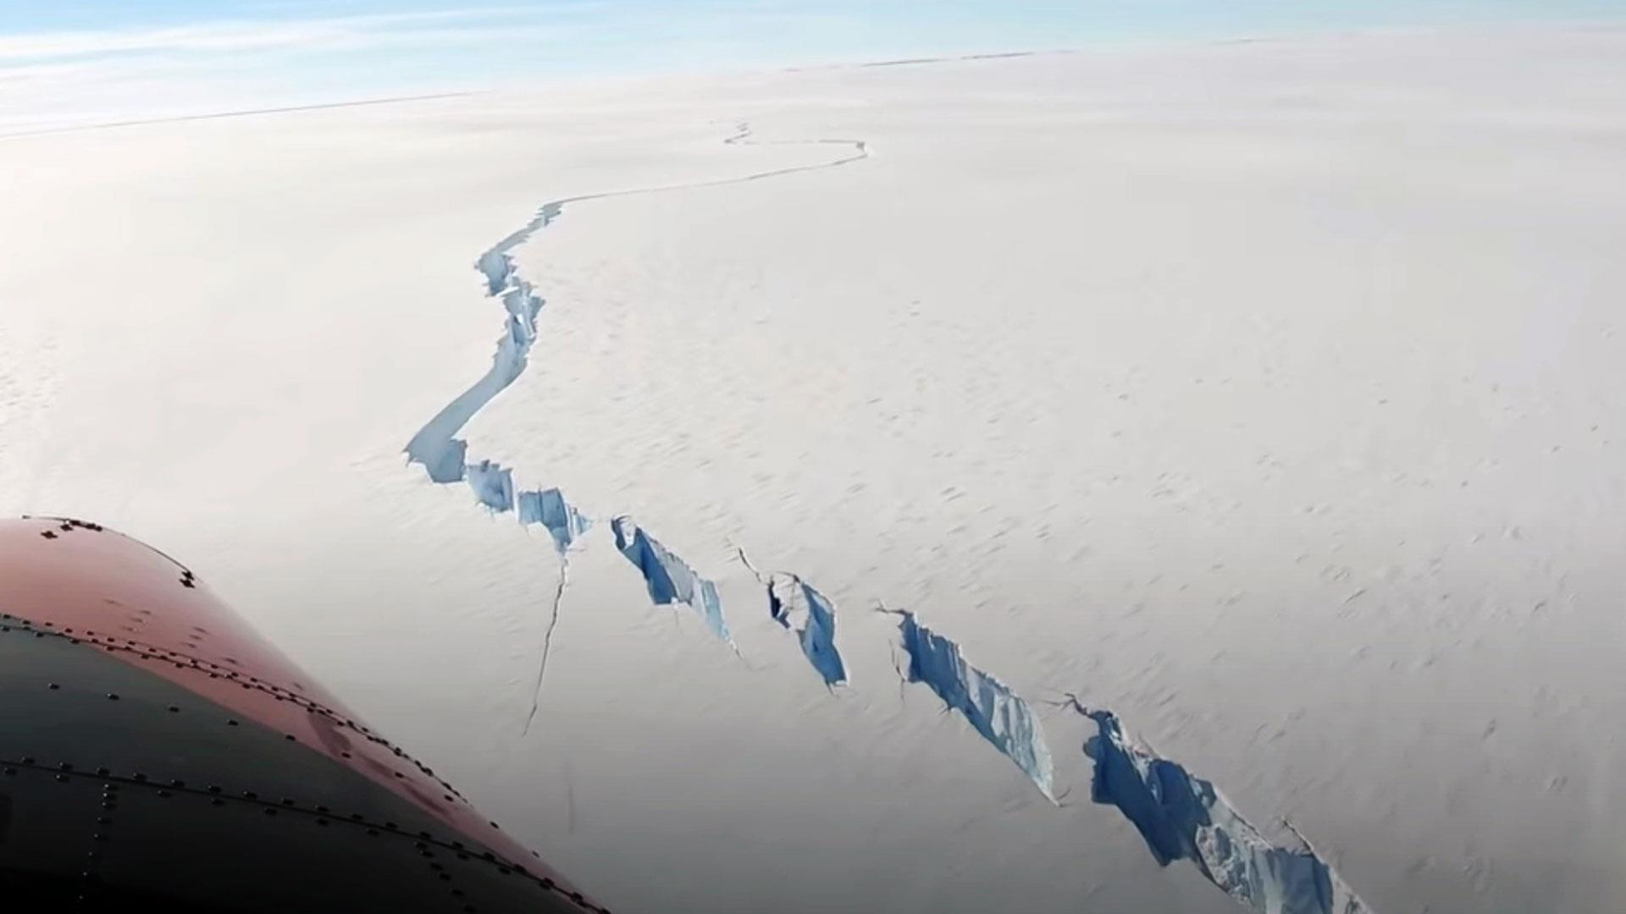
Beyond average sea levels: ice shelf break
Modelled rates assume steady ice melt
Abrupt ice shelf break can occur, cussing sudden sea level surges

Slide 25
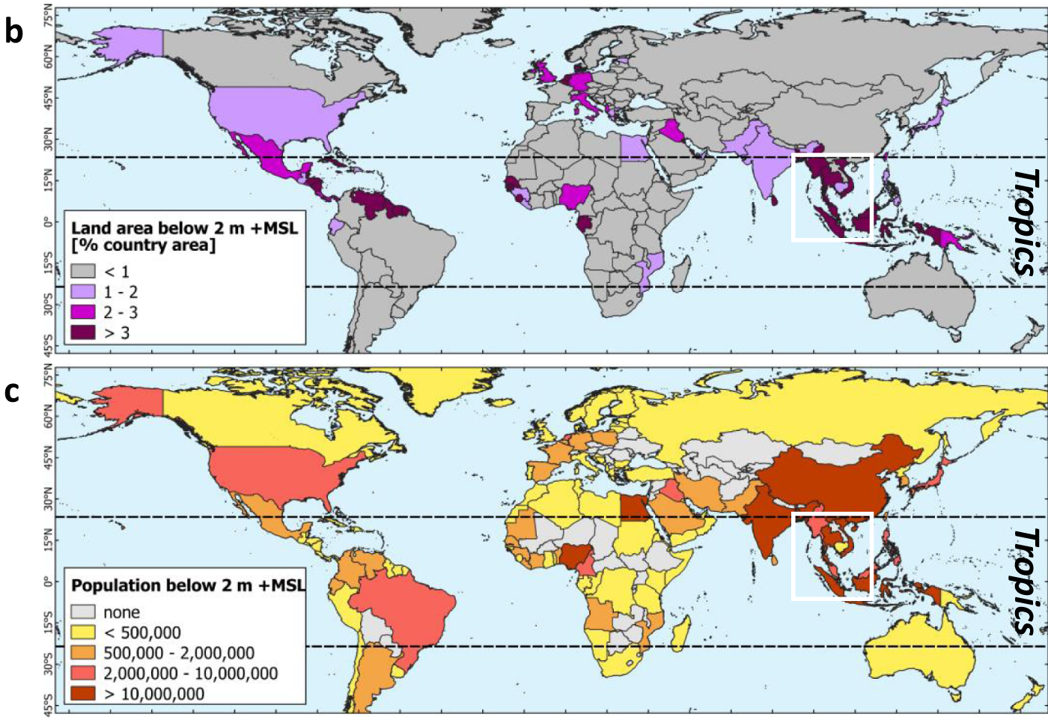
A significant fraction of the Earth’s population lives in coastal areas
Notes:
https://www.nature.com/articles/s41467-021-23810-9

Slide 26
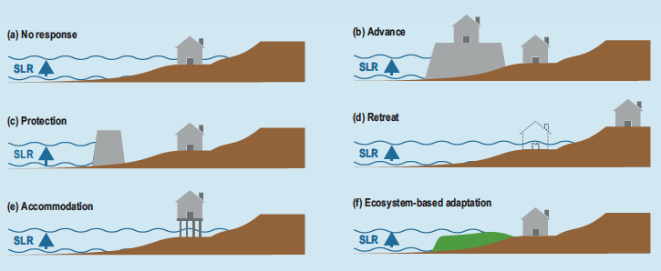
What can we do? Types of adaptation

Slide 27
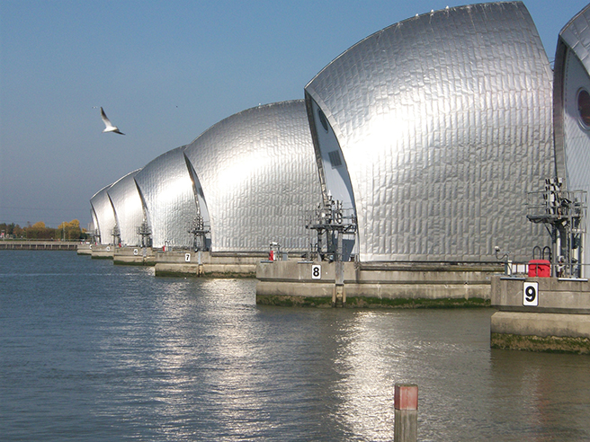
Protection – flood defences
Built flood defences in low lying areas
Need to understand risk for planning: limited resources, so what and where to build?
Need to know worst case scenario as well as averages

Slide 28
Protection – flood defences
Infrastructure built for certain frequency of events, which changes with climate change
We need to have high end, if unrealistic climate projections to account for low-probability but high impact events

Slide 29
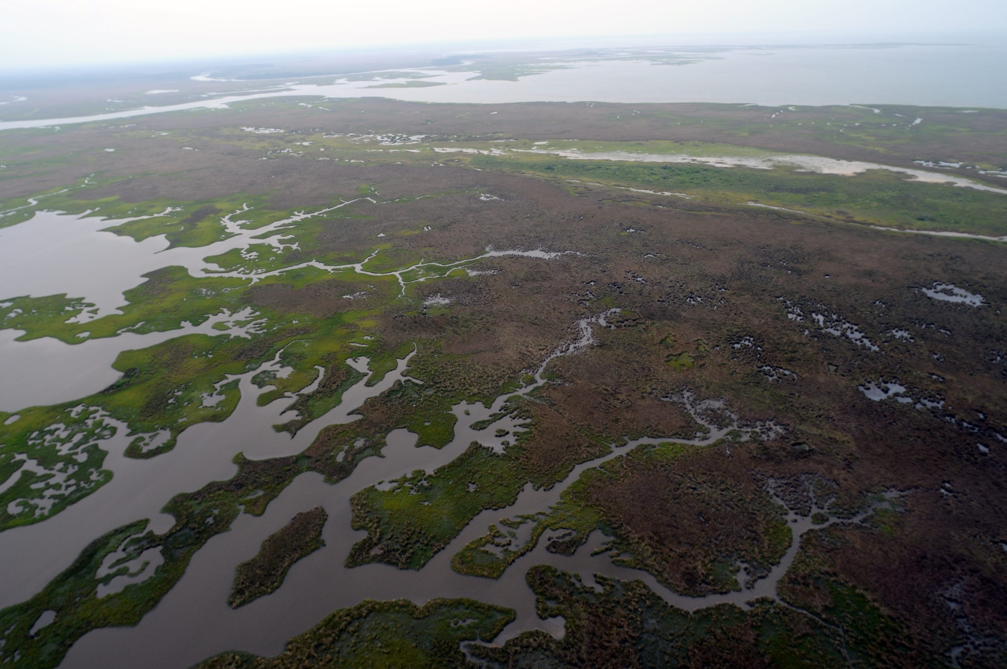
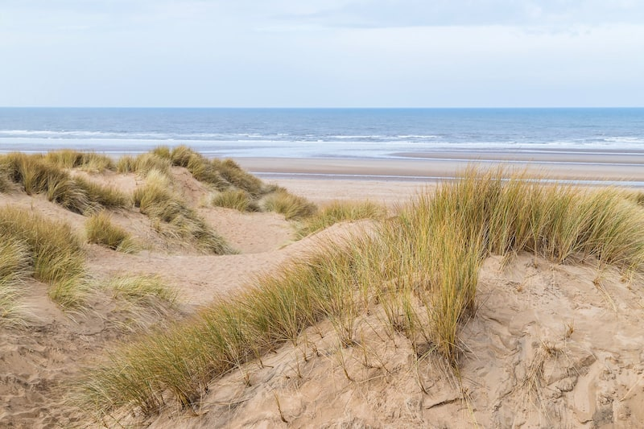
Protection –flood defences
Coastal ecosystems like sand dunes and wetlands can provide protection
Often degraded by human activity
Remember benefits from blue carbon!

Slide 30
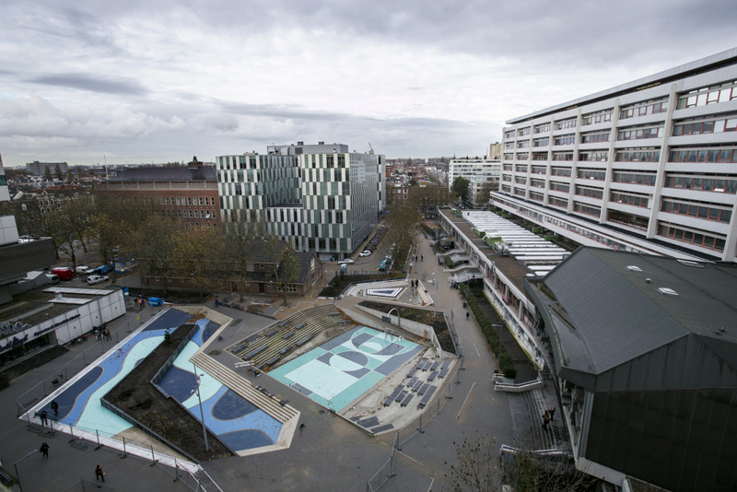
Accommodation: living with water
Building infrastructure that can accommodate regular flooding
Example: water square in Rotterdam

Slide 31
If it gets warmer, ice will melt. D’oh.
Sea level rise
Water supply loss
Habitat loss

Slide 32
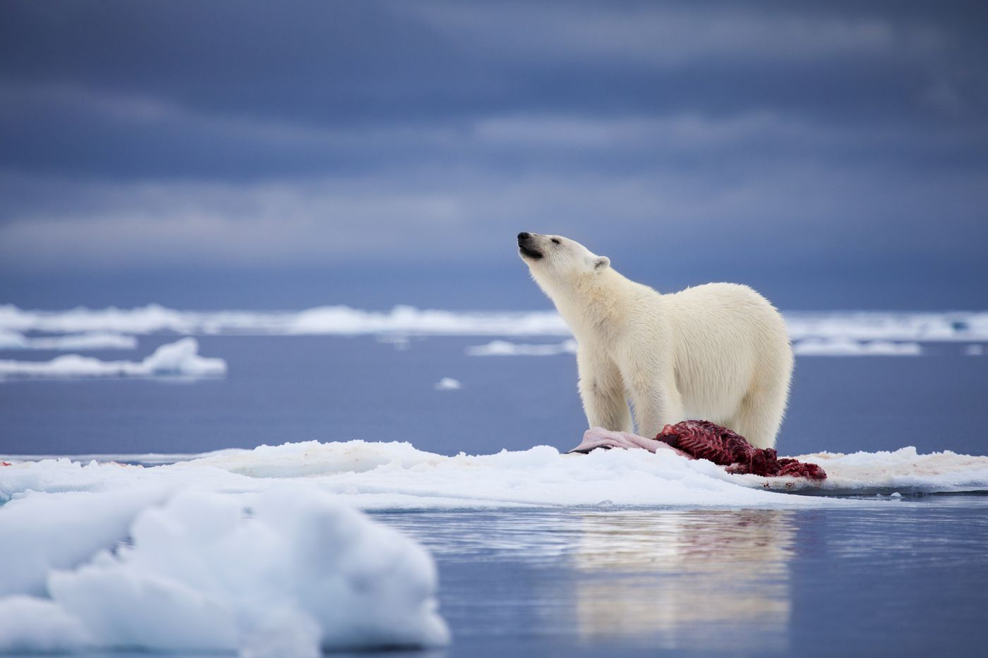
Habitat loss: sea ice ecosystems
Loss of seasonal sea ice impacts Arctic ecosystems and livelihoods
Certain species rely on sea ice being present

Slide 33
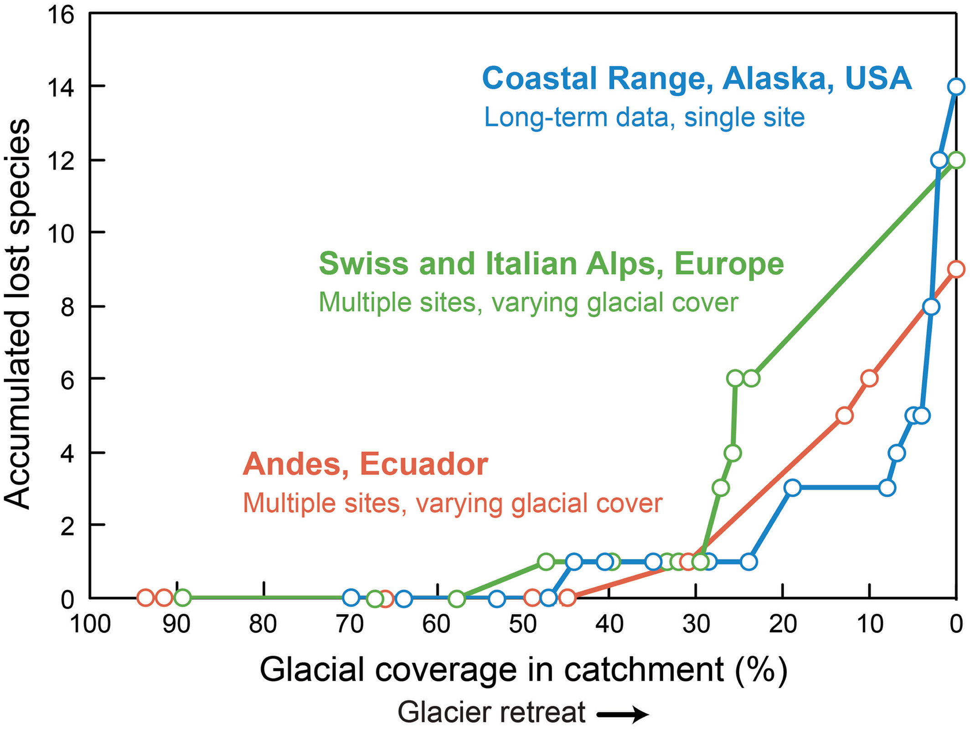
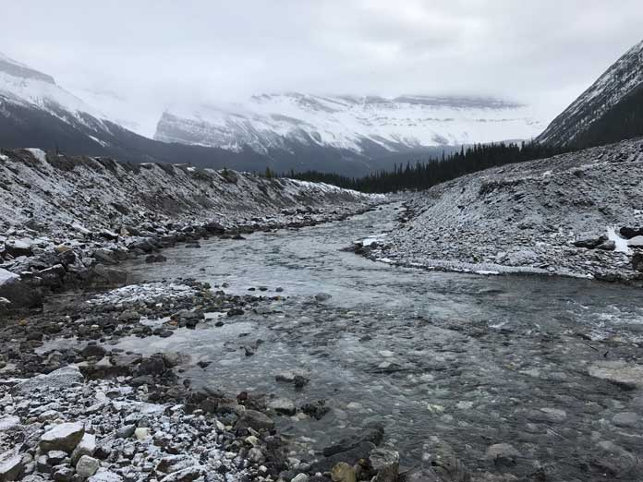
Habitat loss: glacier ecosystems
Severe species loss with retreating glaciers
Notes:
https://www.nature.com/articles/nclimate1435

Slide 34
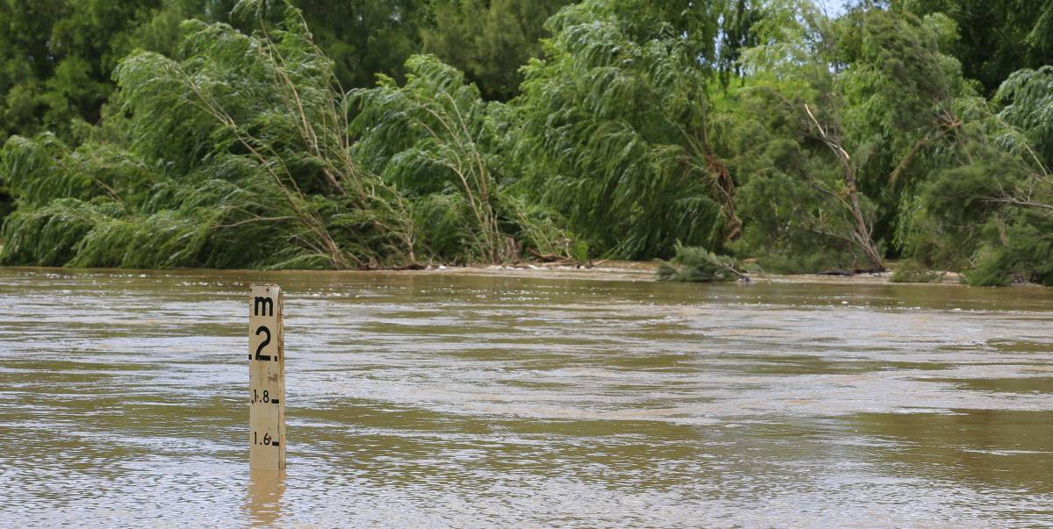
Habitat loss: salinity effects in flooded ecosystems
Sea water flooding brings in salinity
Salinity affects soil composition and pH leading to long term effects

Slide 35
Glaciers: freshwater availability
Mountain glaciers often feed rivers and their melting has impacts farther downhill
Initial melt causes an increase in water
‘Peak water’: water reaches a maximum, but as the glacier gets smaller, amount of melt decreases

Slide 36
Atmosphere
Climate fundamentals
Predicting climate
Atmosphere
Global C cycle
IPCC report
Earth system models
Climate impacts
Climate solutions
Extreme events
Tipping points
Sea ice, ice caps
Energy
Mitigation
Nature-based solutions

